Slide 1
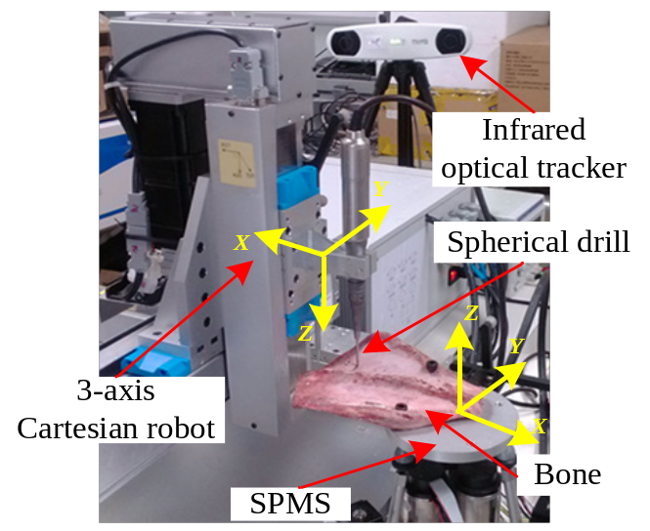
Spinal Physiological Motion Simulator and Compensation Method for a Robotic Spinal Surgical System
Bing Li and Min Fang
Harbin Institute of Technology Shenzhen Graduate School, Shenzhen, China
Haiyang Jin, Ying Hu and Peng Zhang
Shenzhen Institutes of Advanced Technology, Shenzhen, China
A respiratory model based on the ventilator flow waves is proposed.
A spinal physiological motion simulator (SPMS), which is based on a 3-RPS parallel mechanism, is developed for simulating the SPM due to the respiratory model.
A compensation algorithm based on weighted frequency linear combiner (WFLC), is proposed for a robotic surgical system in this paper.
Motion compensation experiments with SPMS

